Slide 1
Build an app that sells snacks
Lê Thị Thanh Hiền
Đặng Tường Vy

Slide 2
Topic introduction
The topic "Building an app to sell snacks" was born to serve to create for users that customers can easily buy their favorite foods without having to go out to search. At the same time, you do not have to worry about food safety issues. As well as creating conditions for stores to be able through a marketing channel to introduce and promote their products to customers. Facilitate the search for familiar customers and even distant customers who have never used the store's products.

Slide 3
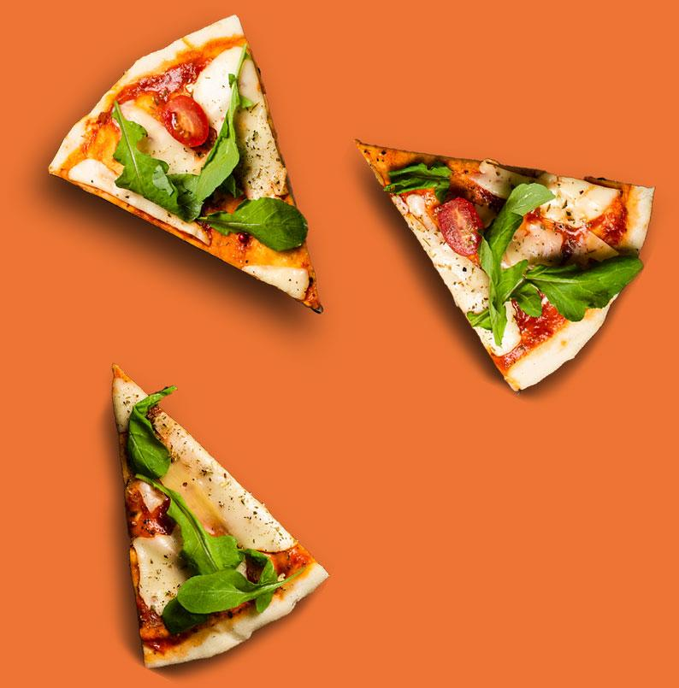
Technology used
Java language
PHP server connection
MySQL database

Slide 4
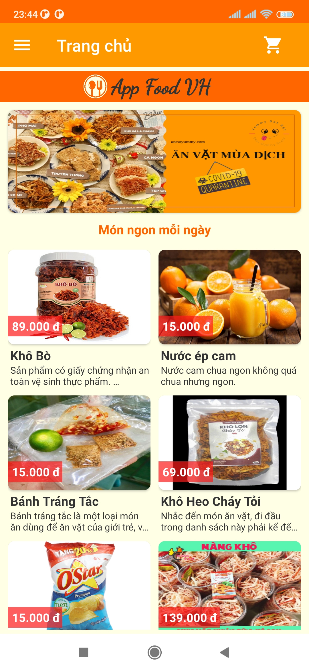
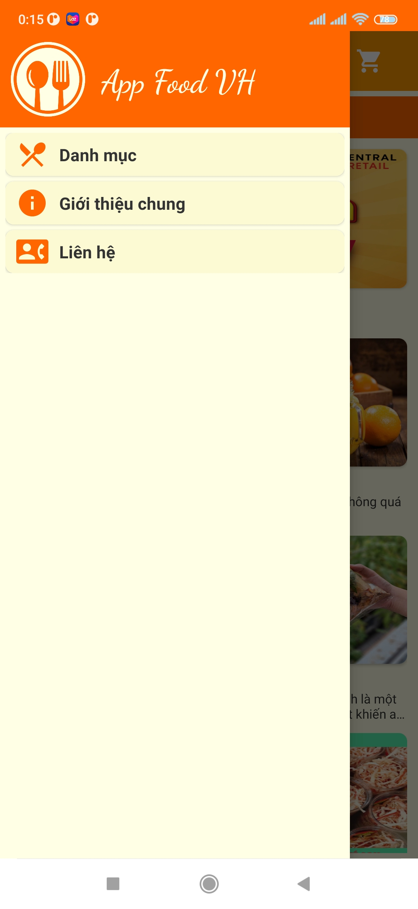
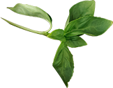
DESCRIPTION AND GUIDELINES FOR USING THE APP
2
1
HOME
In the upper left corner is the menu bar to open the application options including:
view catalog
view general introduction
view store contact information.

Slide 5
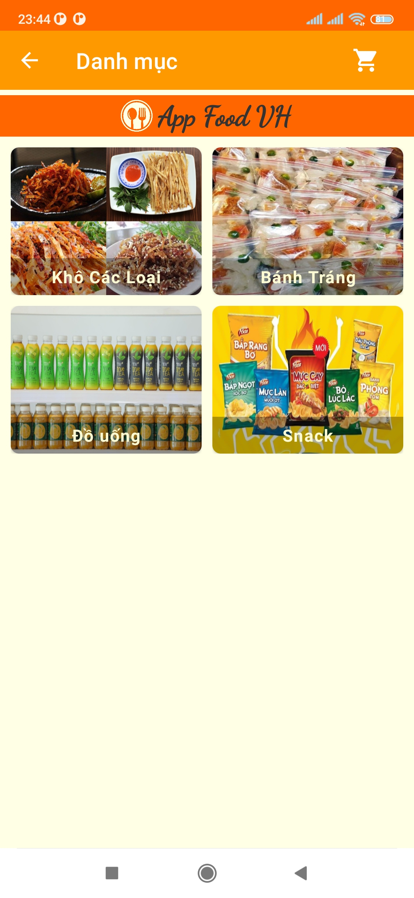
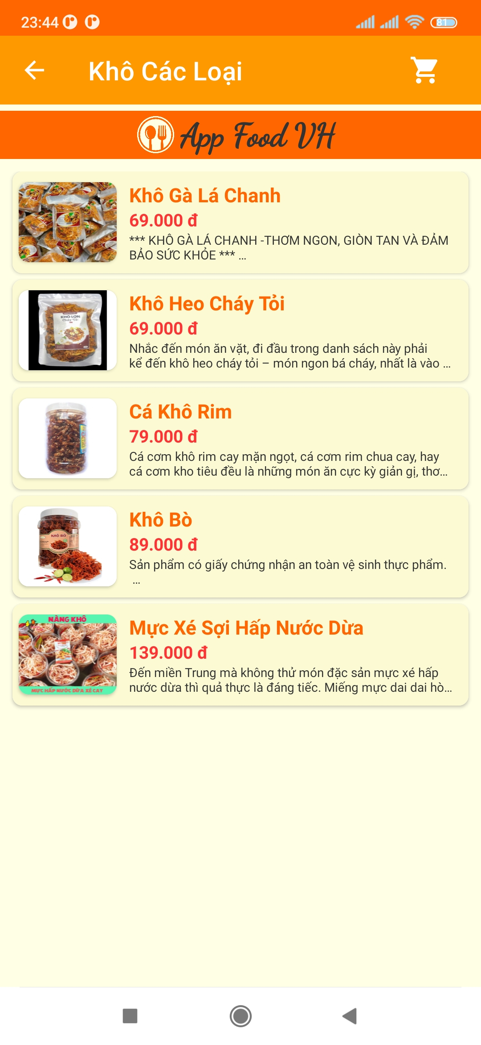
Category screen and product screen

Slide 6
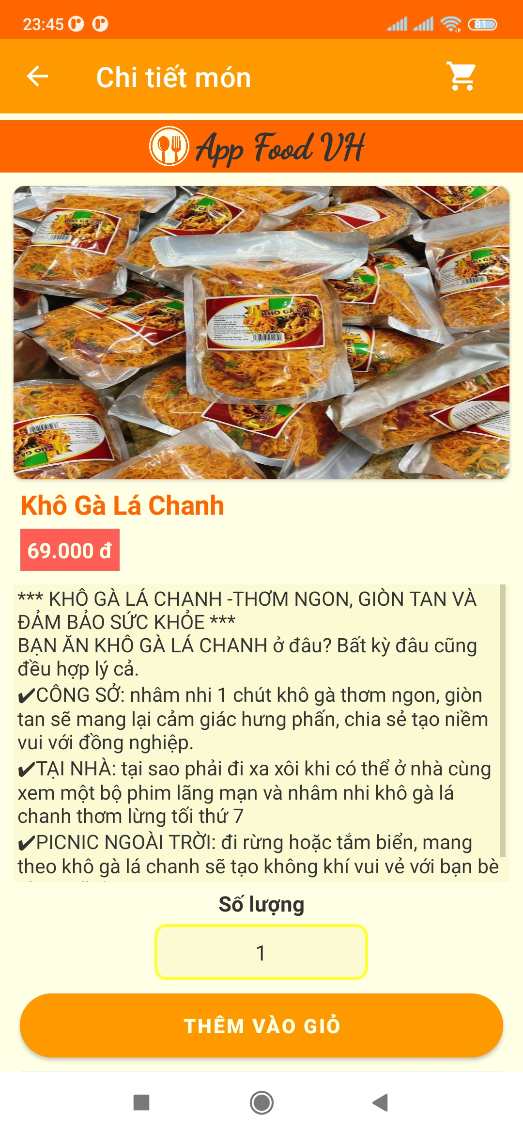
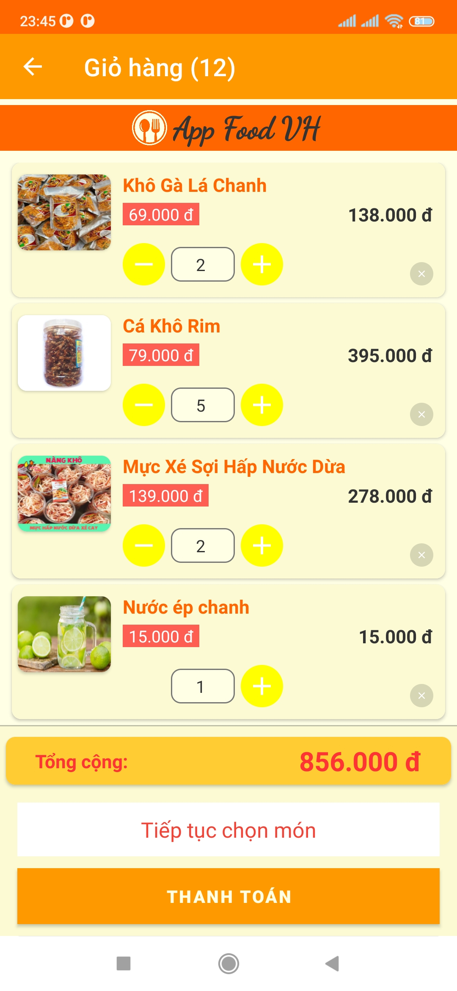
Product detail screen and shopping cart screen
1
2
Product detail screen
Shopping cart screen

Slide 7
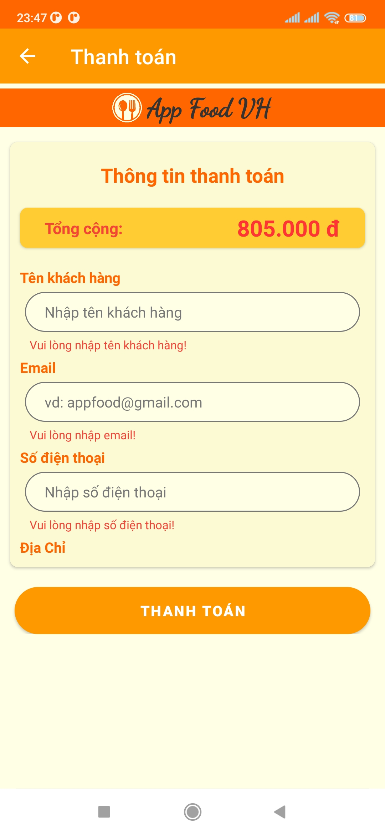
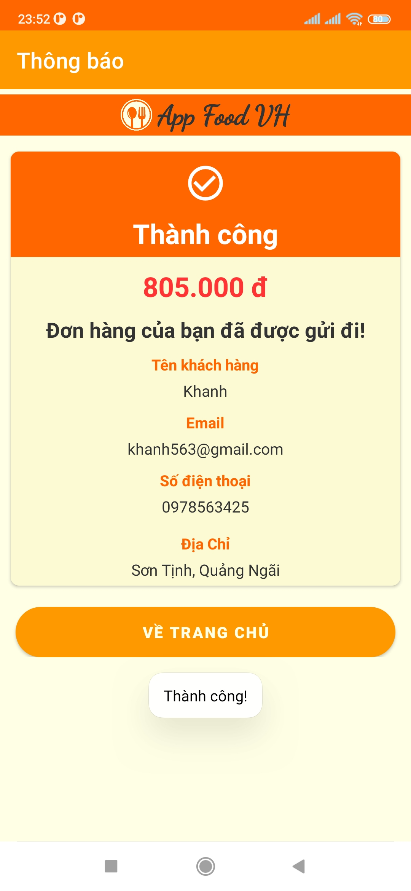
Payment Screen and Notification Screen
1
2
Product detail screen
Shopping cart screen

Slide 8
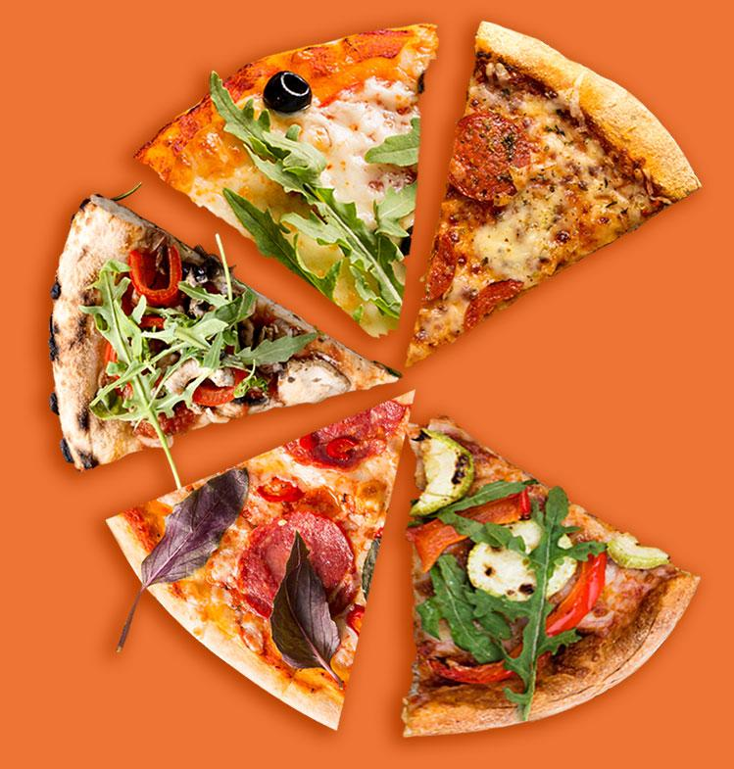
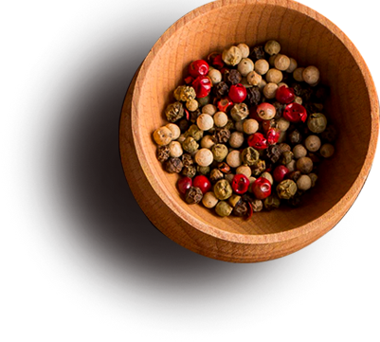
Development
Through this course, we have gained a lot of experience about android applications as well as building them step by step. The future direction of my team will be to develop applications that use socket IO to be able to perform real-time ordering, payment, and information operations. And more than that, I also want to apply more modern and advanced technologies in the future to promote the current food ordering application.

Slide 9
Thank you for listening

